Slide 1
Info 7325 – Introduction to IT Auditing Final Project Alpha Investments INc.
Rishi Raj Dutta
Kaushal Chaudhary
Mohit Ruke
Gauresh Chavan
Zexu Huang
Rishi Rajani

Slide 2
Index
Revision about last time
Organization Chart
Procedures and Policies
Audit Approach
Cloud Architecture

Slide 3
Alpha Investments Inc.
The Company is a start up aimed at helping people multiply their money
The service(s) we are looking at for our company are
Showcasing a client his correct portfolio
Showing the client predictions regarding some investments
Compliances maintained : PII, PCI, MNPI and SEC
Our cloud architecture had different VPC’s for the different coasts and we have revised it today

Slide 4
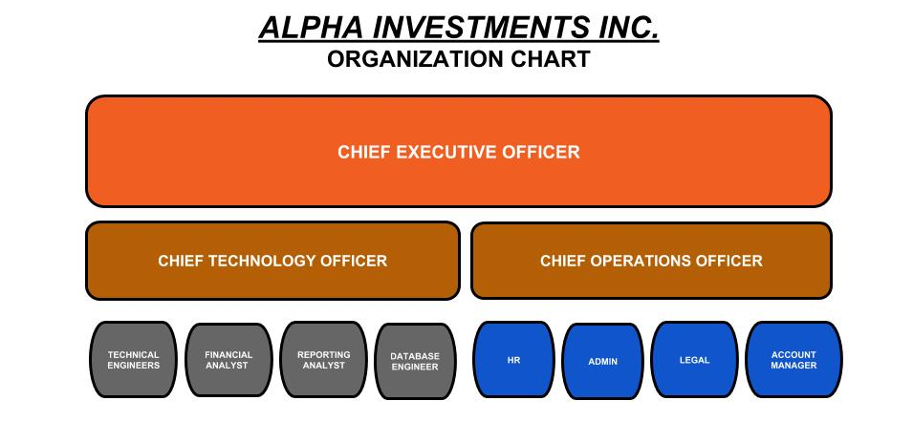

Slide 5
Policies and Procedures
Access Control Policy
Access enforcement (role based, identity based, attribute based and mechanisms: acl, acm, cryptography)
Information flow enforcement
Separation of Duties
Unsuccessful login attempts
System Use notifications
Information Security Management Policy
Access to and Correction of personal information
Data breach procedure and response plan
Privacy Inquiry and complaints procedure
Product Information and Transparency Policy
Clear and concise disclosure
Disclosure requirement for advertisement

Slide 6
Employee, Visitor and Contractor Physical Security Policy
Non-company visitors with issued ‘VISITOR’ status
Non-company visitors with issued ‘Non-Visitor’ status
Company assigned contractors and non-company personnel
New employees
Ethics Policy
Proper use of company, customer and supplier resources
Safeguarding information
Financial management
Acceptance of Business courtesies
Conflict of Interest
Fraud Reporting and Detection Policy
Misappropriation of funds, securities and other assets
Profiteering as a result of inside knowledge of company activities
Disclosing confidential and proprietary information to outside parties
Limited Liability disclosure Policy

Slide 7
AUDIT APPROACH
Planning Phase
Preparing the Audit Plan
Scheduling and open meeting
Conducting Field work
Drafting a Report
Set up a Closing Meeting
Documentation and creation of Reports

Slide 8
3D - Cloud Architecture
Kindly follow this link

